Slide 1
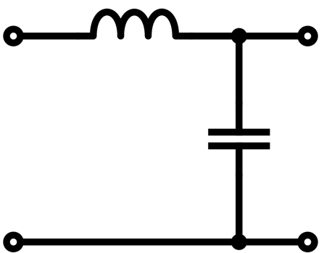
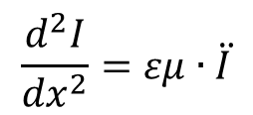
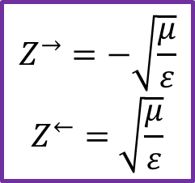

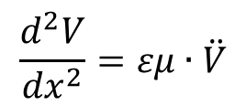
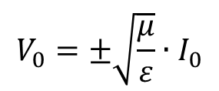
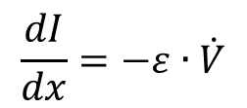

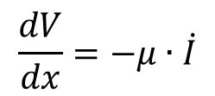


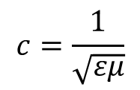
Telegrapher’s equation
$$μ dx$$
$$\frac{dV}{dx}=−μ∙\dot{I}$$
$$\frac{d^{2}V}{{dx}^{2}}=εμ∙\ddot{V}$$
$$c=\frac{1}{\sqrt{εμ}}$$
$$ε dx$$
$$\frac{dI}{dx}=−ε∙\dot{V}$$
$$\frac{d^{2}I}{{dx}^{2}}=εμ∙\ddot{I}$$
$$V_{0}=±\sqrt{\frac{μ}{ε}}∙I_{0}$$
$$V\left(x,t\right)=V_{0}∙e^{ik\left(x±ct\right)}$$
$$Z^{→}=−\sqrt{\frac{μ}{ε}}$$
$$Z^{←}=\sqrt{\frac{μ}{ε}}$$
$$I\left(x,t\right)=I_{0}∙e^{ik\left(x±ct\right)}$$

Slide 2
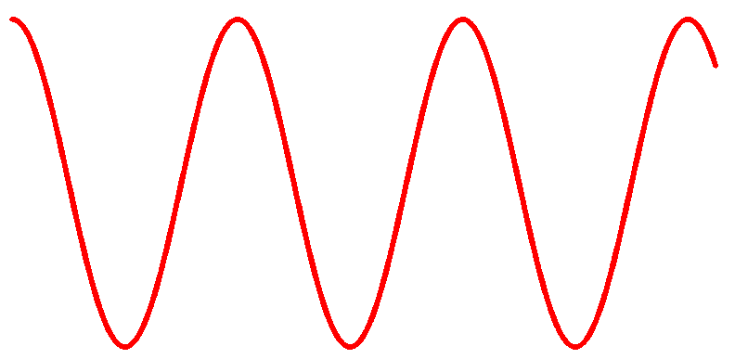
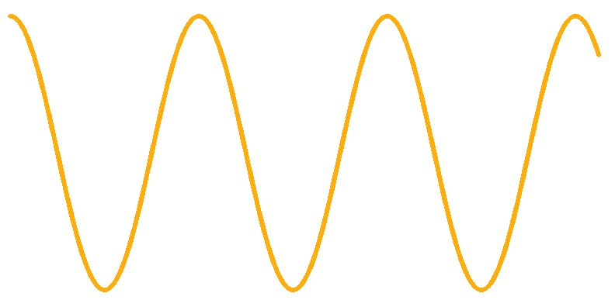




$$y=\frac{H}{E}$$
$$\vec{y}=1$$
$$E$$
$$H$$

Slide 3



$$y=\frac{H}{E}$$
$$\overset{⃖}{y}=−1$$
$$E$$
$$H$$

Slide 4





$$y=\frac{H}{E}$$
$$\vec{y}=1$$
$$y=\frac{H}{E}=2$$
$$\vec{y}=2$$
$$\overset{⃖}{y}=−1$$
$$\overset{⃖}{y}=−2$$
$$E$$
$$H$$
WRONG !
OK !

Slide 5
$$y=\frac{H}{E}$$
$$\vec{y}=1$$
$$y=\frac{H}{E}=2$$
$$\vec{y}=2$$
$$\overset{⃖}{y}=−1$$
$$\overset{⃖}{y}=−2$$
$$E$$
$$H$$
OK !
OK !

Slide 6





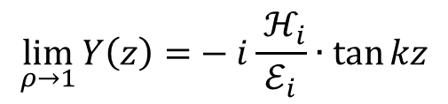

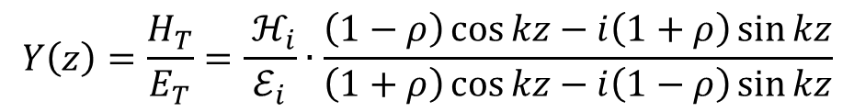






The reflection is able to change the local admittance
$$E_{r}$$
$$E_{i}=ℰ_{i}e^{i(ωt−kz)}$$
$$E_{r}=ℰ_{r}e^{i(ωt+kz)}$$
$$ℰ_{r}={ρ∙ℰ}_{i}$$
$$H_{r}$$
$$E_{i}$$
$$H_{i}=ℋ_{i}e^{i(ωt−kz)}$$
$$H_{r}={−ℋ}_{r}e^{i(ωt+kz)}$$
$$ℋ_{r}={ρ∙ℋ}_{i}$$
$$H_{i}$$
$$z$$
$$0$$
$$E_{T}=E_{i}+E_{r}=\left[2ρ\cos{kz+\left(1−ρ\right)}e^{−ikz}\right] ℰ_{i}e^{iωt}$$
$$H_{T}=H_{i}+H_{r}=\left[−i2ρ\sin{kz}{+\left(1−ρ\right)}e^{−ikz}\right]{ ℋ}_{i}e^{iωt}$$
The fields depend on time The admittance is independent of time
$$Y\left(z\right)=\frac{H_{T}}{E_{T}}=\frac{{ ℋ}_{i}}{ℰ_{i}}∙\frac{\left(1−ρ\right)\cos{kz−i\left(1+ρ\right)}\sin{kz}}{\left(1+ρ\right)\cos{kz−i\left(1−ρ\right)}\sin{kz}}$$
$$\lim_{ρ→1}{Y\left(z\right)=}−i\frac{{ ℋ}_{i}}{ℰ_{i}}∙\tan{kz}$$

Slide 7
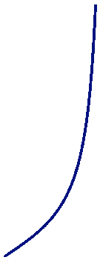





$$Y$$
$$E$$
$$× \cos{(ωt)}$$
$$H$$
$$× \sin{(ωt)}$$

