Slide 1
Characterization of optical coatings
Master CDIM
G. Cagnoli

Slide 2
Overview
Optical
  Spectrophotometry
  (R and T)
  Ellipsometry
  (n, k, thickness)
  Absorption
  Scattering
  Wave front distortion
Mechanical
  Stress and thermal expansion
  Adhesion
  Wearing
  Elastic constants

Slide 3
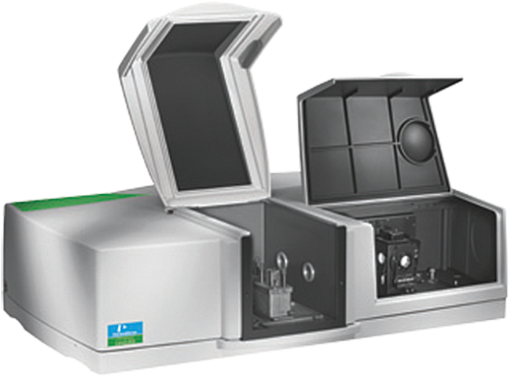
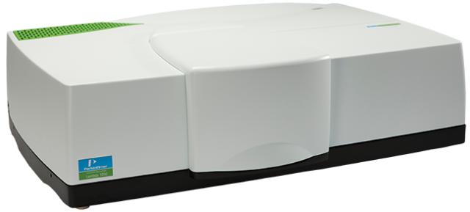
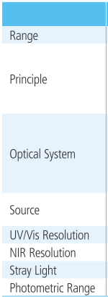
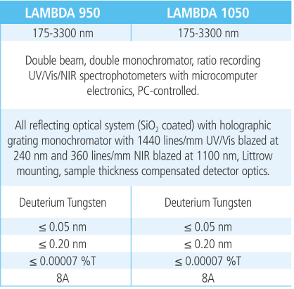
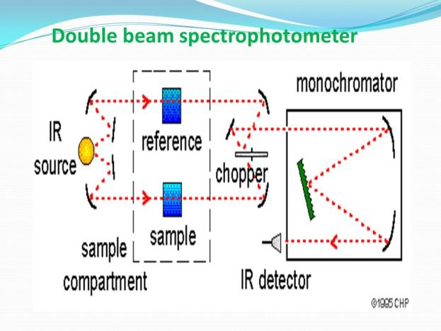
A spectrophotometer
LAMBDA 1050 Perkin Elmer

Slide 4
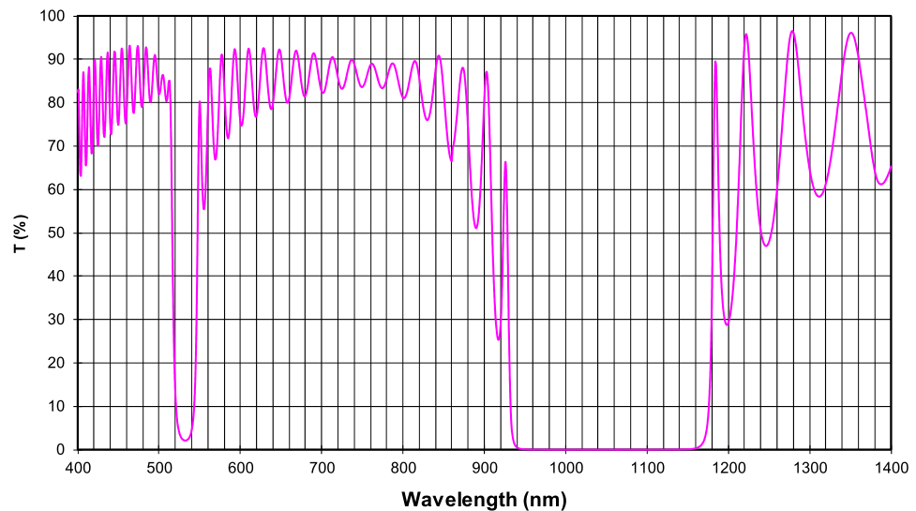
Example: Virgo HR

Slide 5
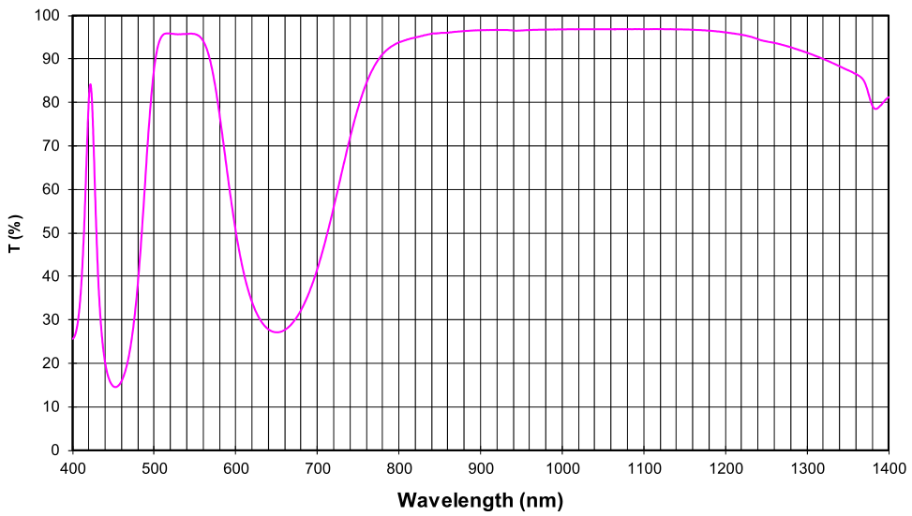
Example: Virgo AR

Slide 6
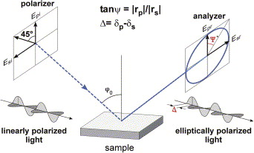
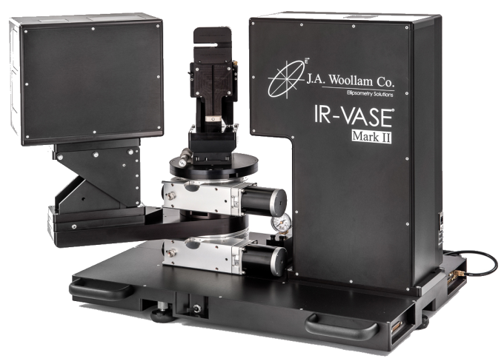
Ellipsometry

Slide 7
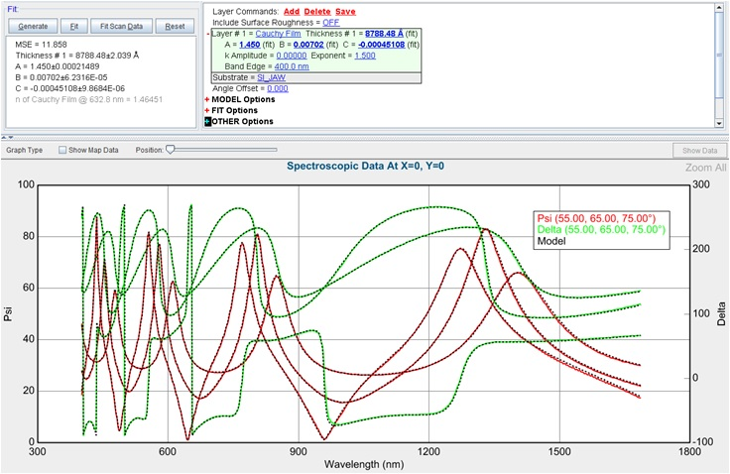
Ellipsometry: example on a single film

Slide 8
Absorption measurements
Large absorption
  k is so large that can be measured with spectrophotometer or ellipsometry
Low absorption
  Bolometric effect, but longitudinal mapping is impossible
  Mirage effect
  0.1 ppm absorption measurements are possible

Slide 9
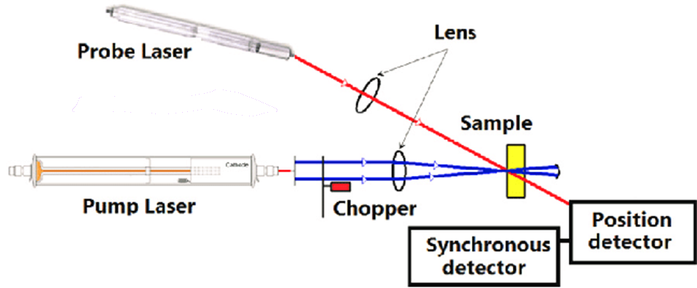
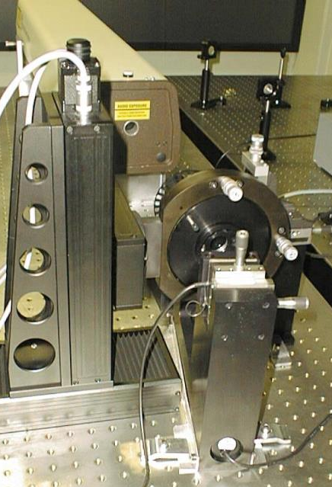
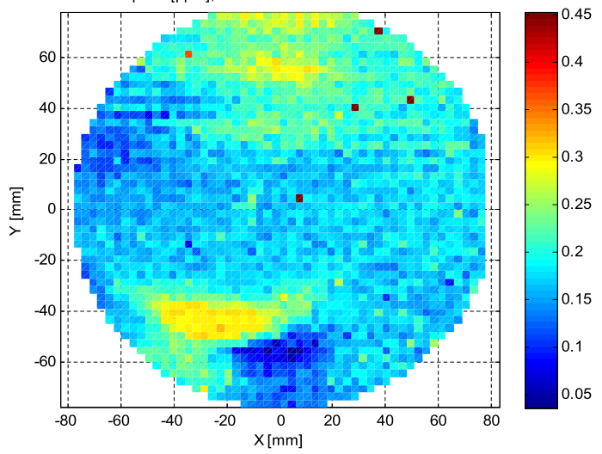
Mirage effect

Slide 10
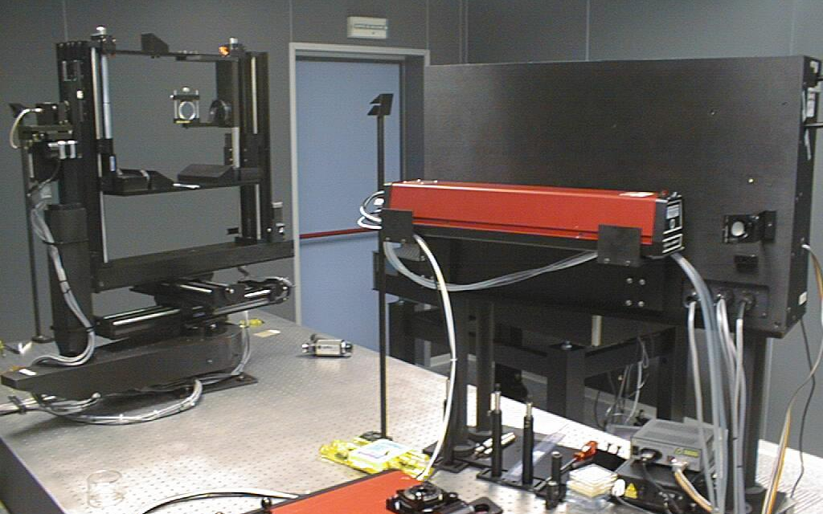

Slide 11
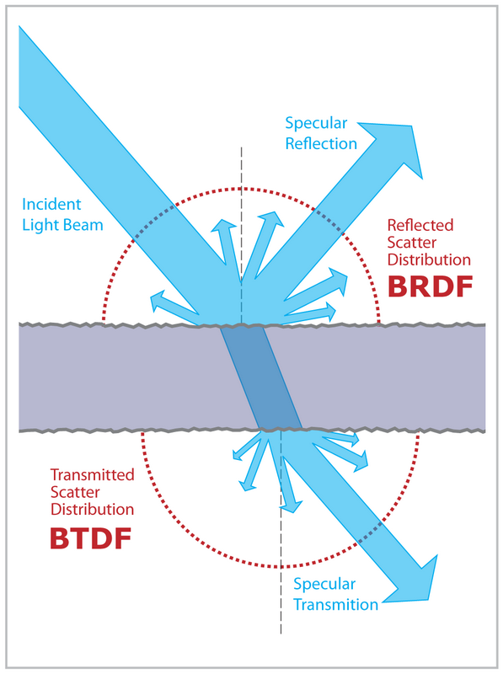

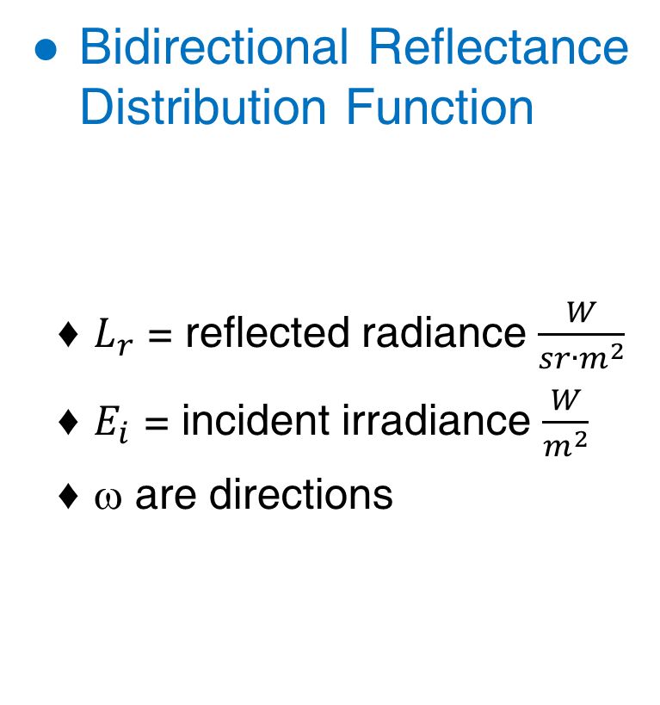
Bidirectional Reflectance Distribution Function
  $L_{r}$ = reflected radiance $\frac{W}{sr∙m^{2}}$
  $E_{i}$ = incident irradiance $\frac{W}{m^{2}}$
  ω are directions

Slide 12
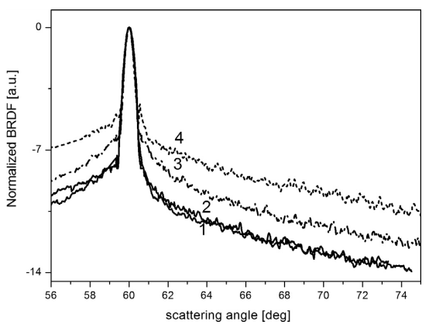
BRDF example measurements

Slide 13
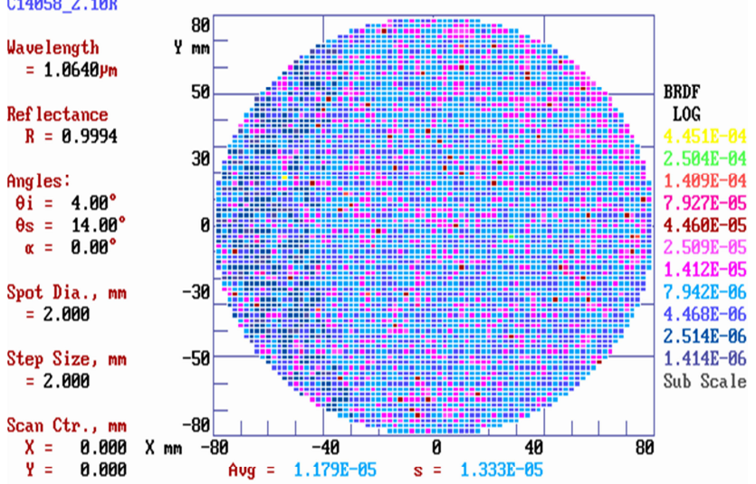
BRDF on Virgo test masses

Slide 14
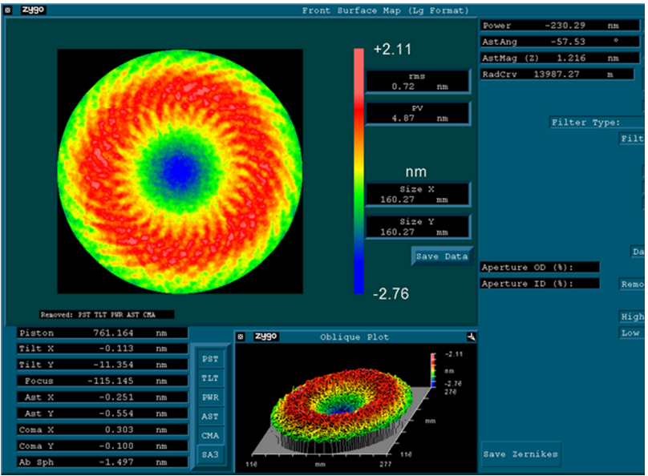
Wave front distortion

Slide 15
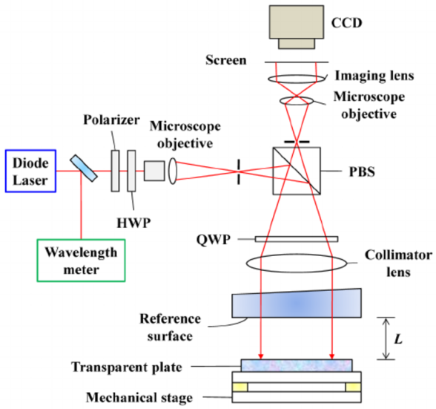
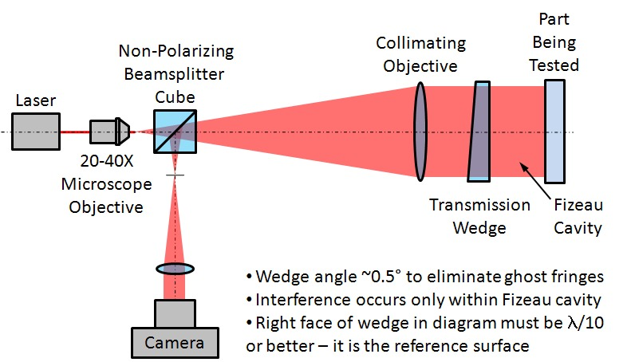
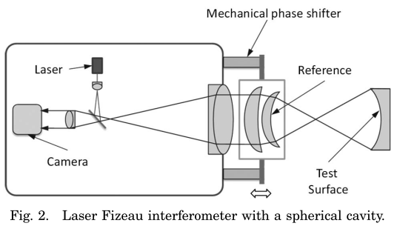
The Fizeau interferometer

Slide 16
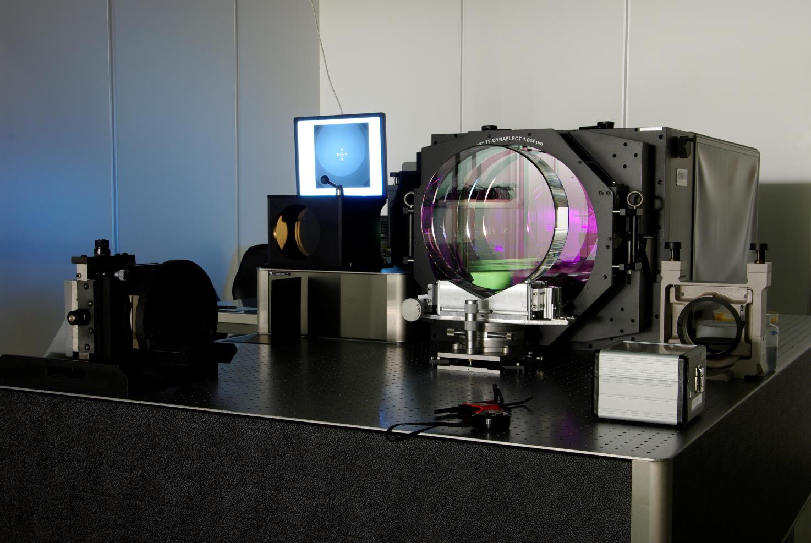
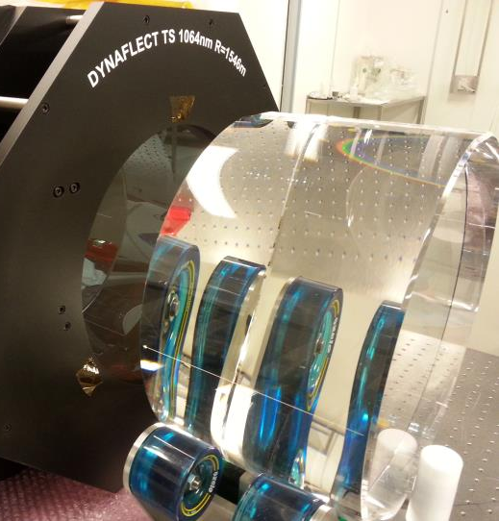
The ZYGO at LMA

Slide 17
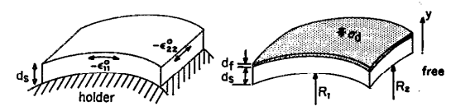
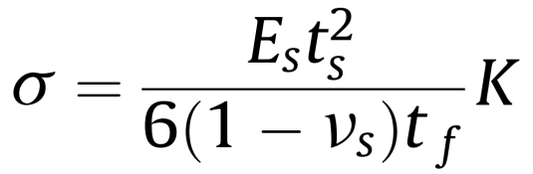
Stress and thermal expansion
The Stoney equation

Slide 18
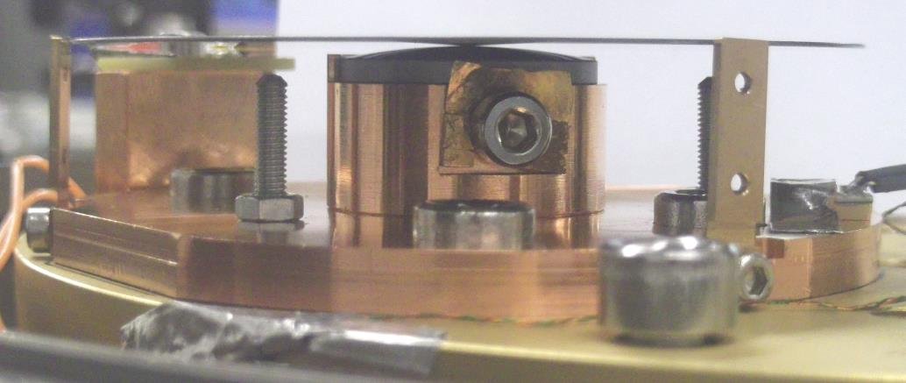
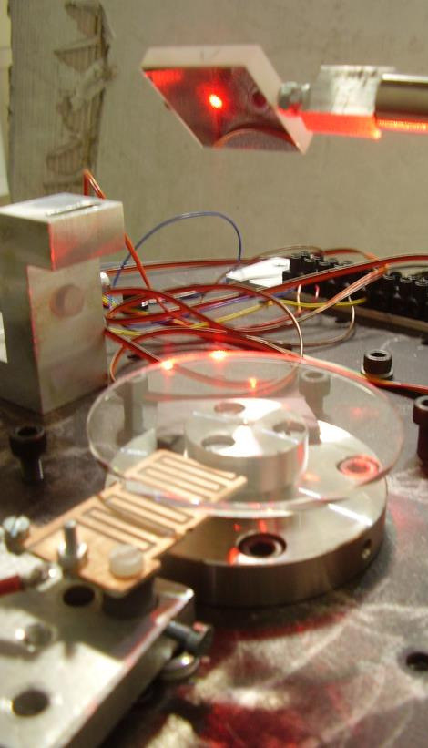
Elastic constants measurement
A revolutionary system is being used at LMA
  Coatings are deposited on thin
  silica discs
  Discs are suspended on spheres
  Modes are excited and detected

Slide 19
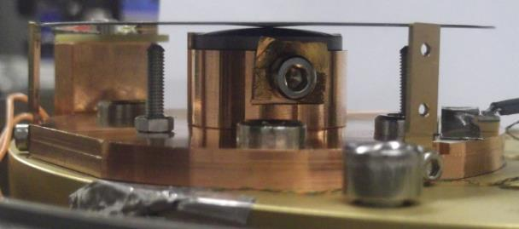
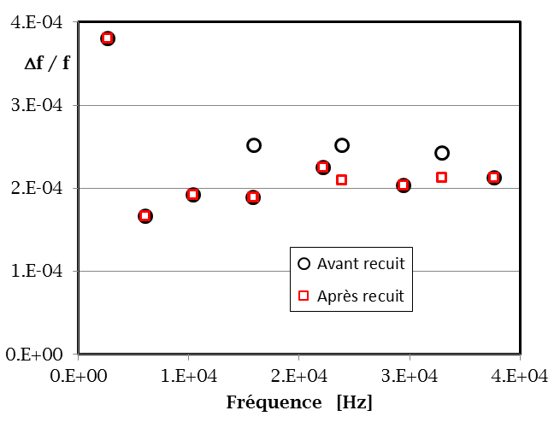
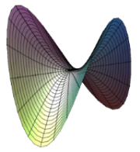
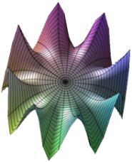
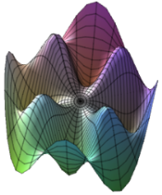
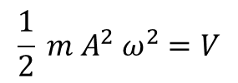

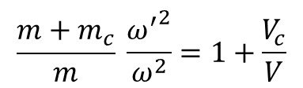
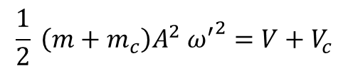
GeNS: measurement principle
$$K=V$$
$$\frac{1}{2} m A^{2} ω^{2}=V$$
$$\frac{m+m_{c}}{m} \frac{{ω^{′}}^{2}}{ω^{2}}=1+\frac{V_{c}}{V}$$
$$\frac{1}{2} \left(m+m_{c}\right)A^{2} {ω^{′}}^{2}=V+V_{c}$$

