Slide 1
Optical Interference Coatings: What, How and where
Les couches minces optiques (cmo)
L’incidence sur une surface de séparation plane
La réflexion par une cmo
La matrice caractéristique d’une cmo
La matrice caractéristique d’une multicouche
Les cas d’une multicouche quart d’onde en incidence normale

Slide 2

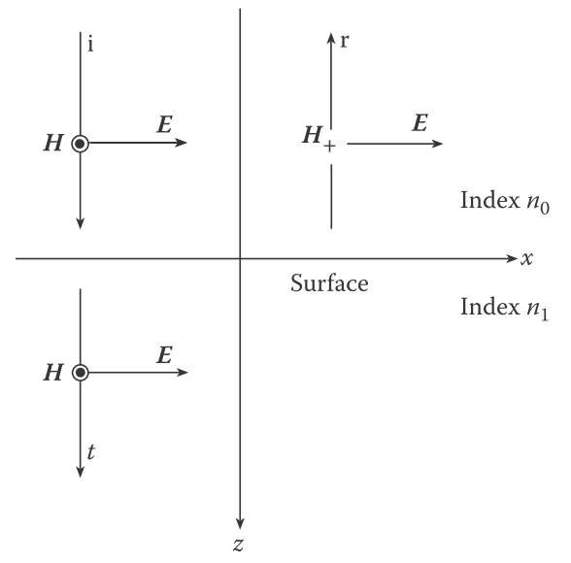










Slide 3





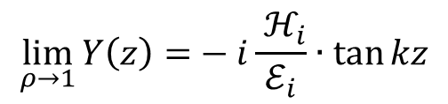

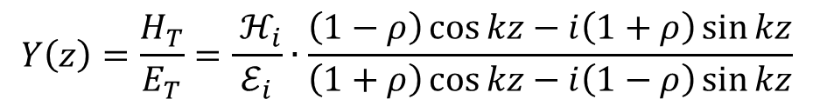






The reflection is able to change the local admittance
$$E_{r}$$
$$E_{i}=ℰ_{i}e^{i(ωt−kz)}$$
$$E_{r}=ℰ_{r}e^{i(ωt+kz)}$$
$$ℰ_{r}={ρ∙ℰ}_{i}$$
$$H_{r}$$
$$E_{i}$$
$$H_{i}=ℋ_{i}e^{i(ωt−kz)}$$
$$H_{r}={−ℋ}_{r}e^{i(ωt+kz)}$$
$$ℋ_{r}={ρ∙ℋ}_{i}$$
$$H_{i}$$
$$z$$
$$0$$
$$E_{T}=E_{i}+E_{r}=\left[2ρ\cos{kz+\left(1−ρ\right)}e^{−ikz}\right] ℰ_{i}e^{iωt}$$
$$H_{T}=H_{i}+H_{r}=\left[−i2ρ\sin{kz}{+\left(1−ρ\right)}e^{−ikz}\right]{ ℋ}_{i}e^{iωt}$$
$$Y\left(z\right)=\frac{H_{T}}{E_{T}}=\frac{{ ℋ}_{i}}{ℰ_{i}}∙\frac{\left(1−ρ\right)\cos{kz−i\left(1+ρ\right)}\sin{kz}}{\left(1+ρ\right)\cos{kz−i\left(1−ρ\right)}\sin{kz}}$$
$$\lim_{ρ→1}{Y\left(z\right)=}−i\frac{{ ℋ}_{i}}{ℰ_{i}}∙\tan{kz}$$

Slide 4
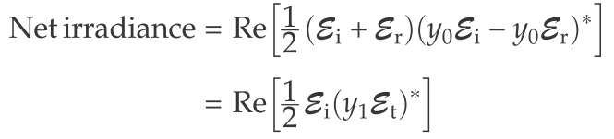

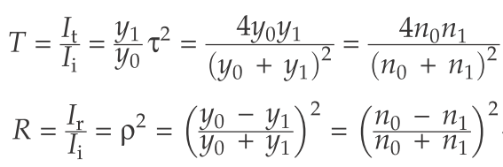

Slide 5
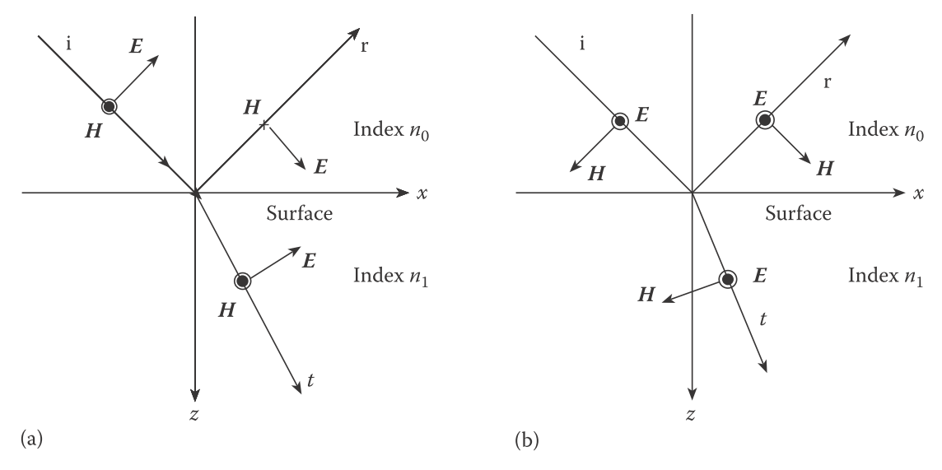



$$θ_{0}$$
$$θ_{1}$$

Slide 6

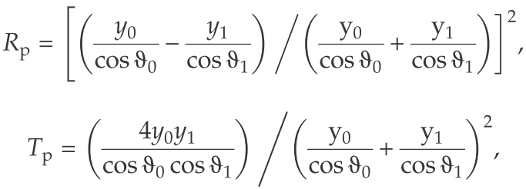
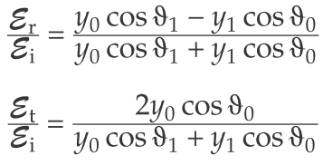

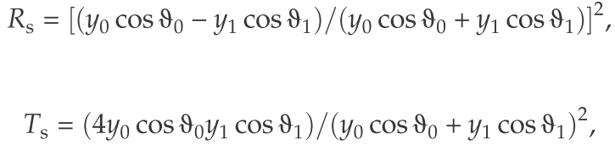

Slide 7


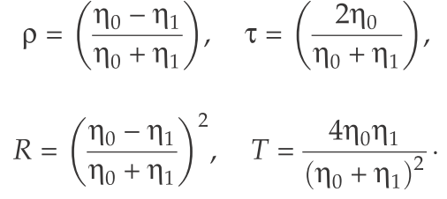

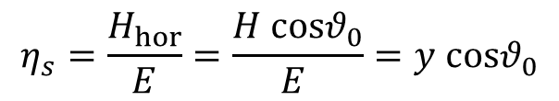
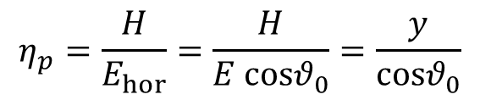

$$η_{p}=\frac{H}{E_{hor}}=\frac{H}{E cosθ_{0}}=\frac{y}{cosθ_{0}}$$
$$θ_{0}$$
$$η_{s}=\frac{H_{hor}}{E}=\frac{H cosθ_{0}}{E }=y cosθ_{0}$$
$$θ_{0}$$

Slide 8
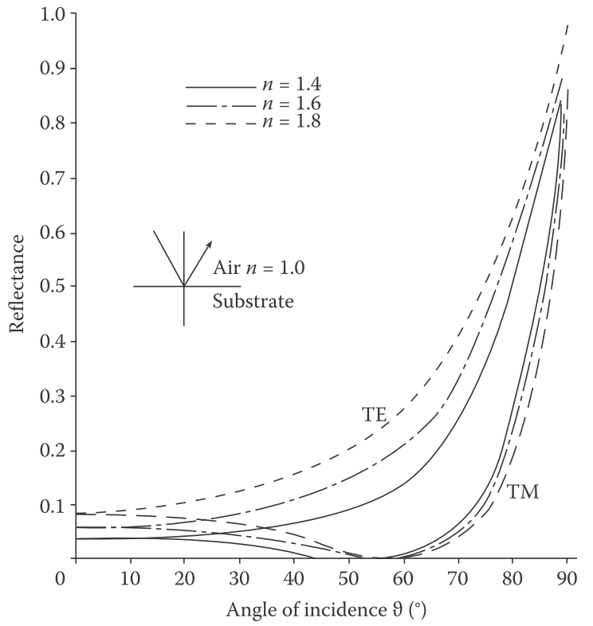

Slide 9
A single thin film case
Onde plane incidente
E_{i}
r
N_{air}
H_{i}
Air
H_{r}
E_{r}
i
a
_
+
N₁
épaisseur physique d
Couche mince
b
H_{t}
E_{t}
N₂
Substrat
t
z
The reflection is able to change the local admittance

Slide 10


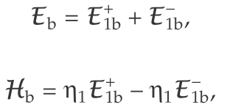
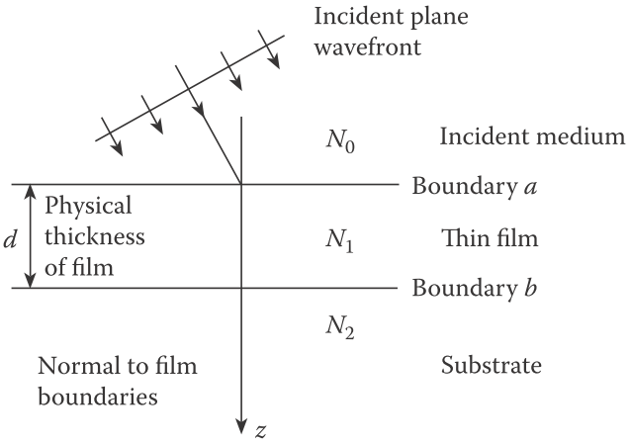




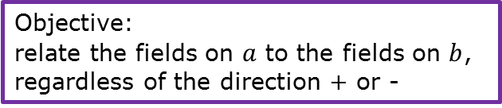
Objective: relate the fields on $a$ to the fields on $b$, regardless of the direction + or -

Slide 11
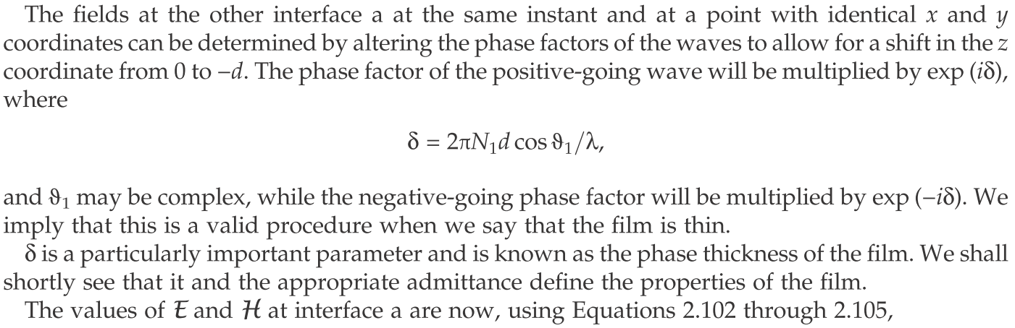





Attention! It is not normal that $cos θ_{1}$ is at the numerator!
a
b

Slide 12
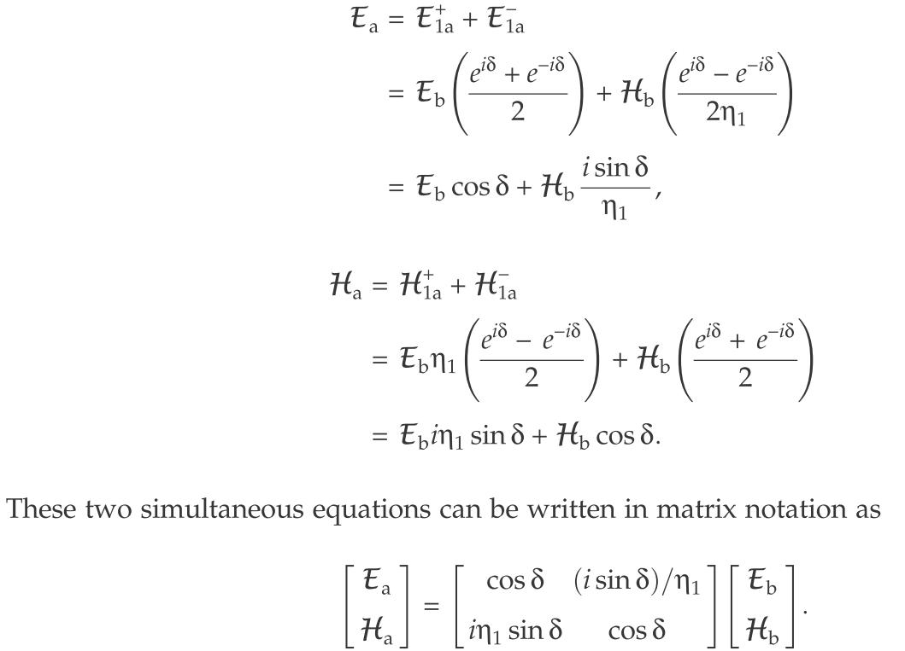

Slide 13
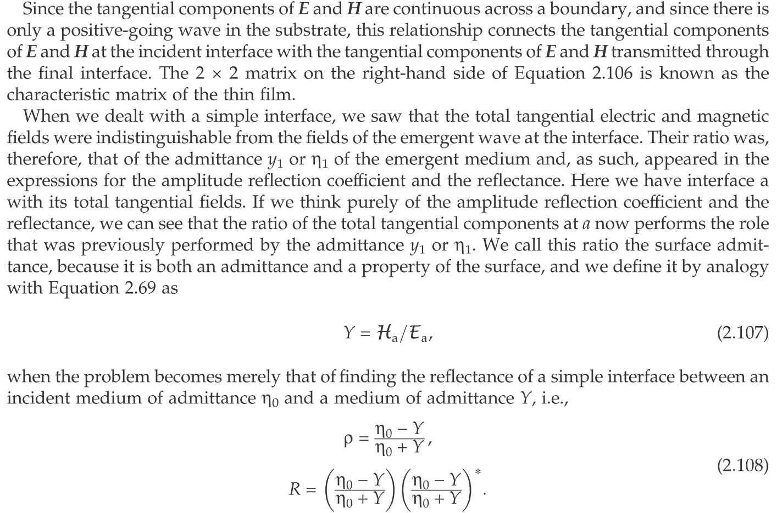

Slide 14
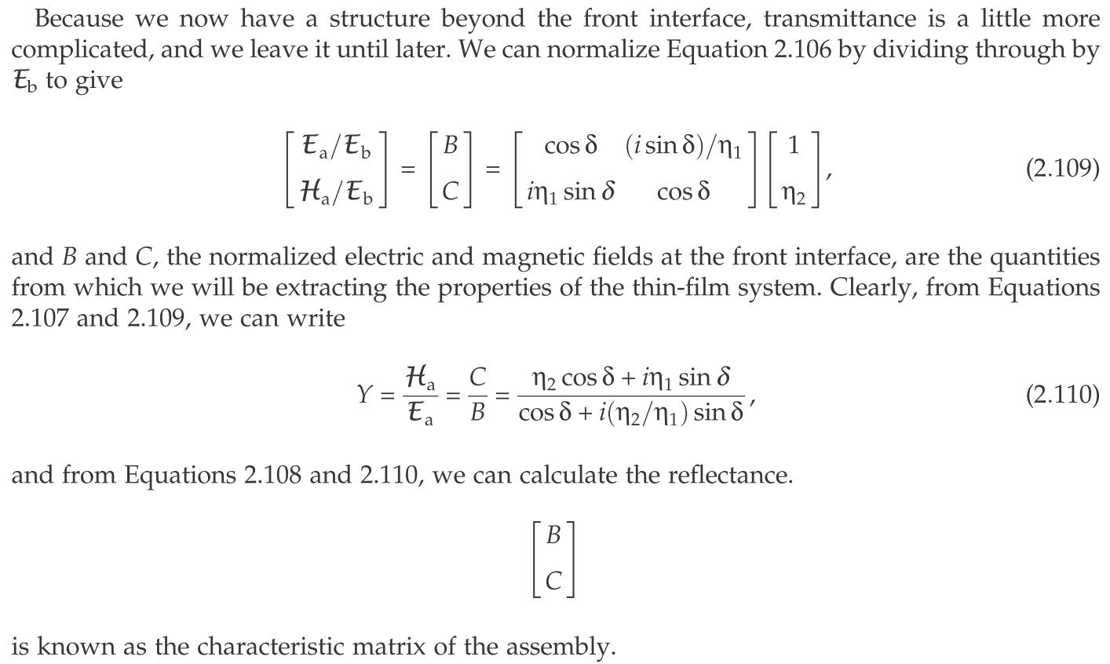

Slide 15
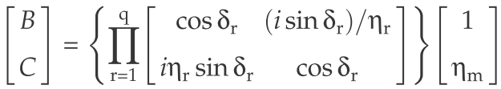
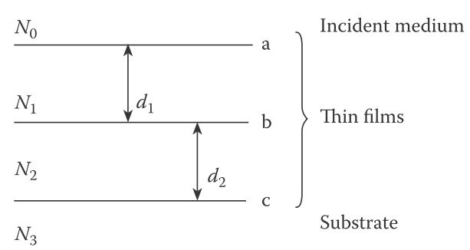




Slide 16
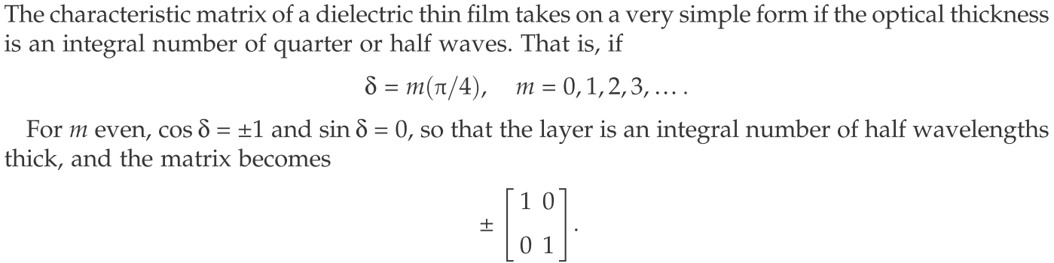
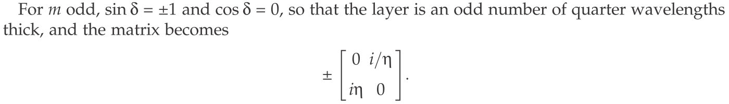
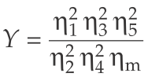

Slide 17

