Slide 1
Chapter 10 – part C
Conservation of Angular Momentum
Dynamics of a rigid object

Slide 2
How to calculate I
For a point-like mass
For a rigid object rotating around its CM: look at the formulas in the book if the shape is a disk, a ring, a sphere or a bar and find
For a rigid object NOT rotating around its CM
o
R
m
o = CM
R
o
CM

Slide 3
Exercise 10.43
43. A particle of mass 0.400 kg is attached to the 100-cm mark of a meter stick of mass 0.100 kg. The meter stick rotates on a horizontal, frictionless table with an angular speed of 4.00 rad/s. Calculate the angular momentum of the system when the stick is pivoted about an axis (a) perpendicular to the table through the 50.0-cm mark and (b) perpendicular to the table through the 0-cm mark.

Slide 4
Exercise 10.47
47. A 60.0-kg woman stands at the rim of a horizontal turntable having a moment of inertia of 500 kg · m² and a radius of 2.00 m. The turntable is initially at rest and is free to rotate about a frictionless, vertical axle through its center. The woman then starts walking around the rim clockwise (as viewed from above the system) at a constant speed of 1.50 m/s relative to the Earth. (a) In what direction and with what angular speed does the turntable rotate? (b) How much work does the woman do to set herself and the turntable into motion?

Slide 5
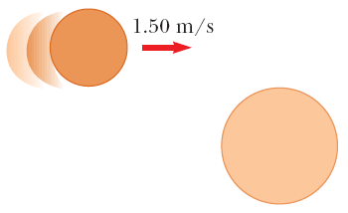
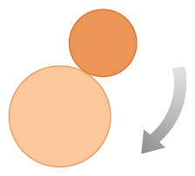
Exercise 10.49
49. A puck of mass 80.0 g and radius 4.00 cm slides along an air table at a speed of 1.50 m/s. It makes a glancing collision with a second puck of radius 6.00 cm and mass 120 g (initially at rest) such that their rims just touch. Because their rims are coated with instant-acting glue, the pucks stick together and spin after the collision. (a) What is the angular momentum of the system relative to the center of mass? (b) What is the angular speed about the center of mass?

Slide 6
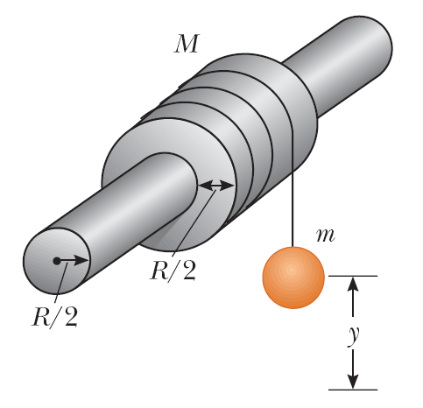
Exercise 10.60
60. A uniform, hollow, cylindrical spool has inside radius R/2, outside radius R, and mass M. It is mounted so that it rotates on a fixed, horizontal axle. A counterweight of mass m is connected to the end of a string wound around the spool. The counterweight falls from rest at t = 0 to a position y at time t. Show that the torque due to the friction forces between spool and axle is

Slide 7
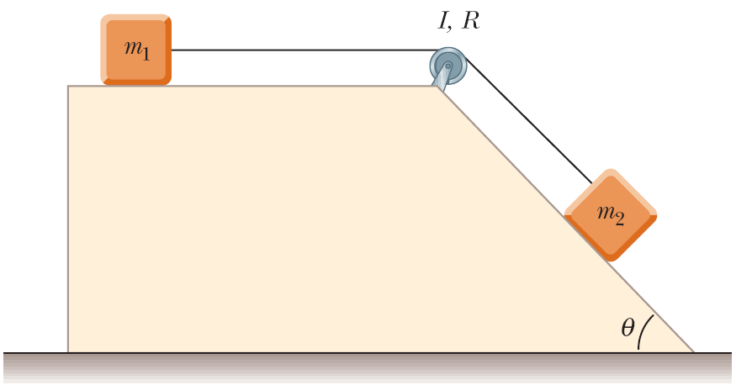
Exercise 10.62
62. A block of mass m₁ = 2.00 kg and a block of mass m₂ = 6.00 kg are connected by a massless string over a pulley in the shape of a solid disk having radius R = 0.250 m and mass M = 10.0 kg. These blocks are allowed to move on a fixed block-wedge of angle θ = 30.0°. The coefficient of kinetic friction is 0.360 for both blocks. Draw free-body diagrams of both blocks and of the pulley. Determine (a) the acceleration of the two blocks and (b) the tensions in the string on both sides of the pulley.

