Slide 1



Aspects of
Fused Silica Suspensions in
Advanced Detectors
Geppo Cagnoli
gianpietro.cagnoli@utb.edu
University of Texas at Brownsville and TSC
LIGO, Hanford –Feb. 2nd 2011

Slide 2
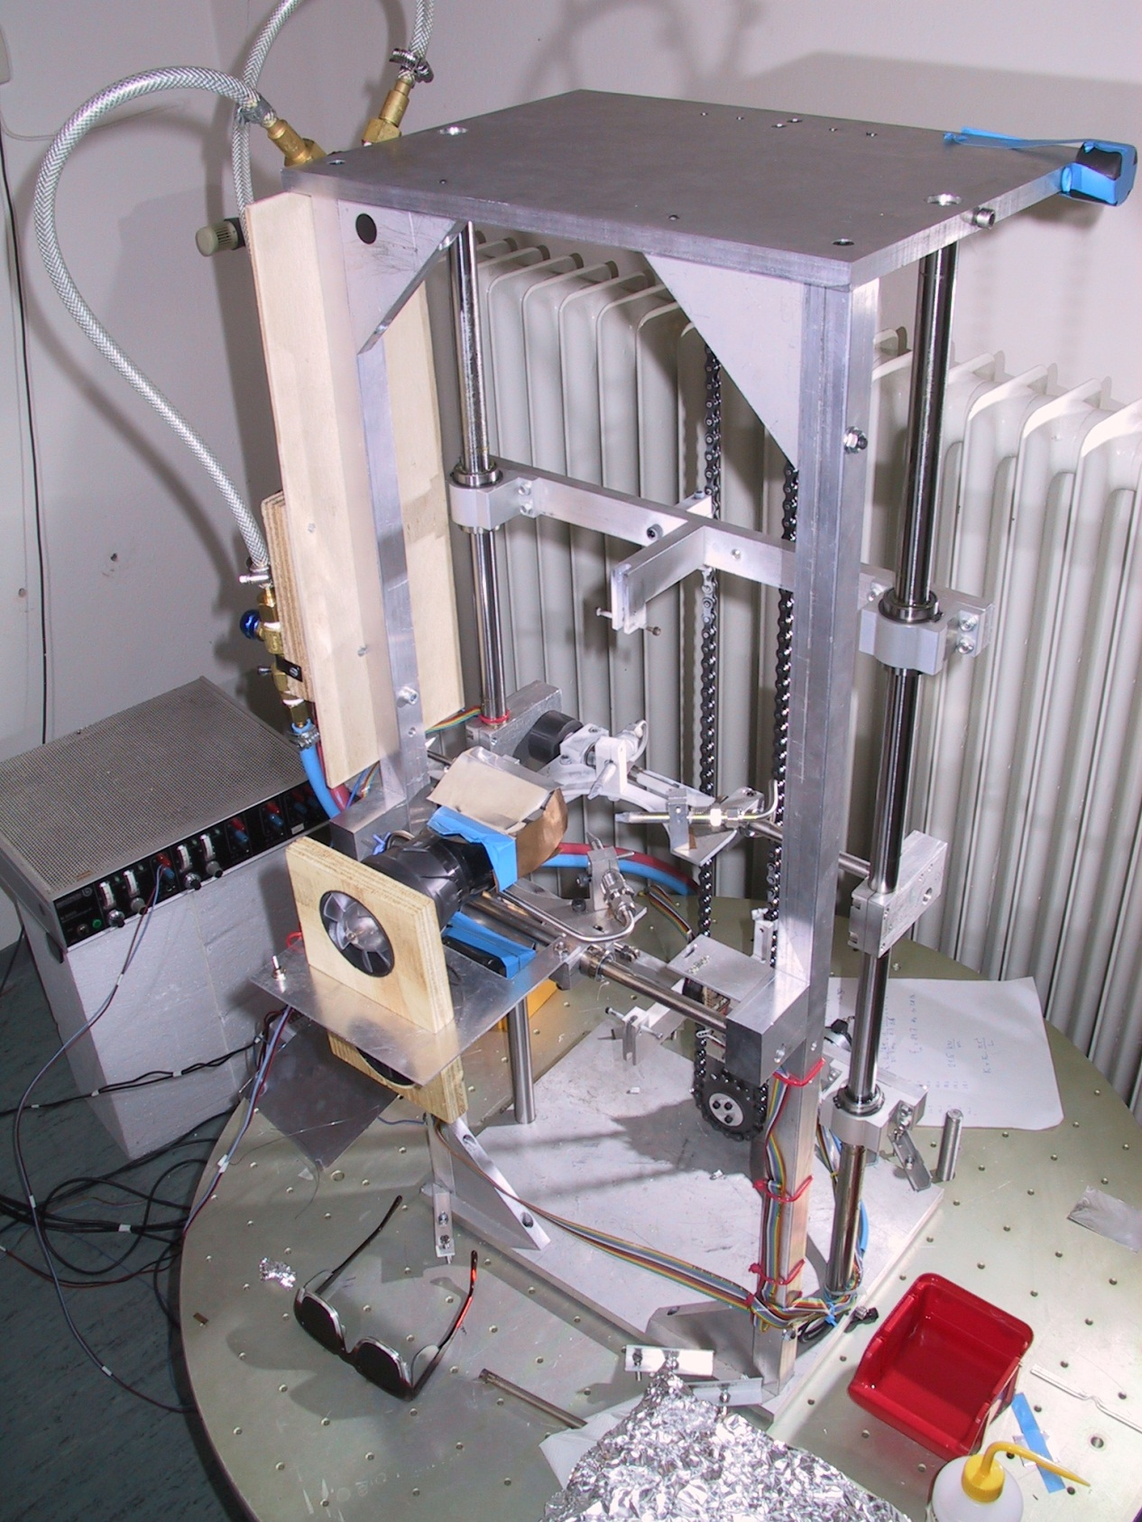
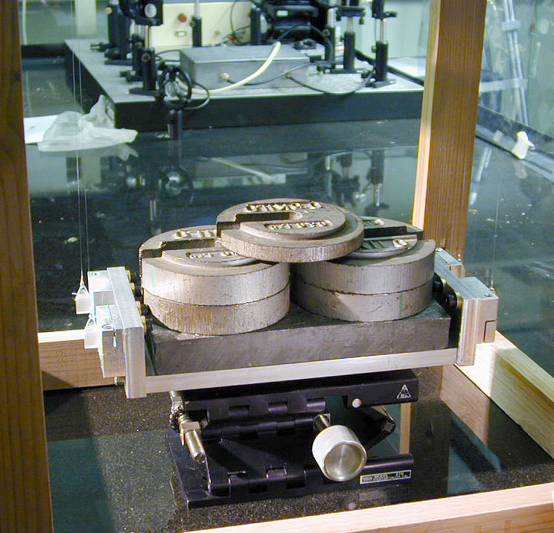
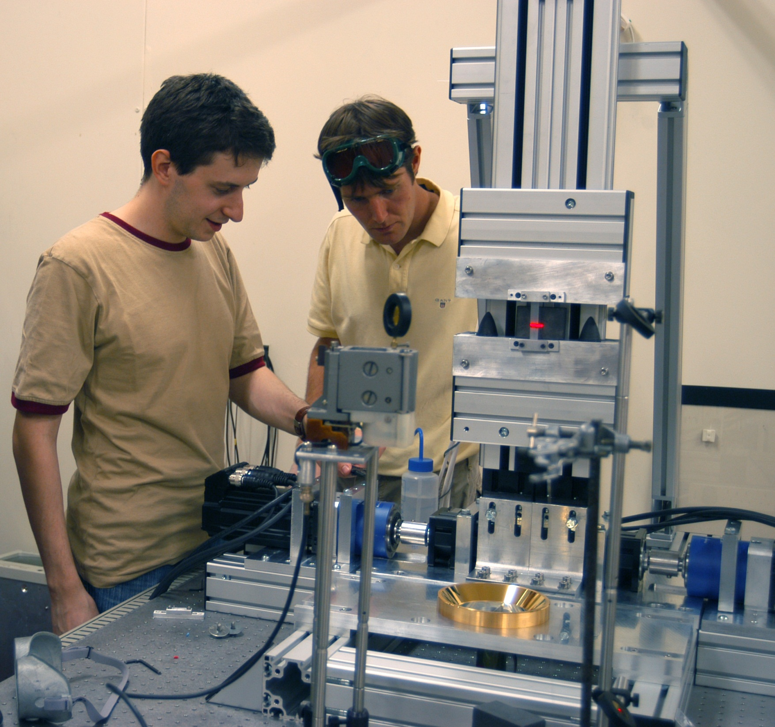
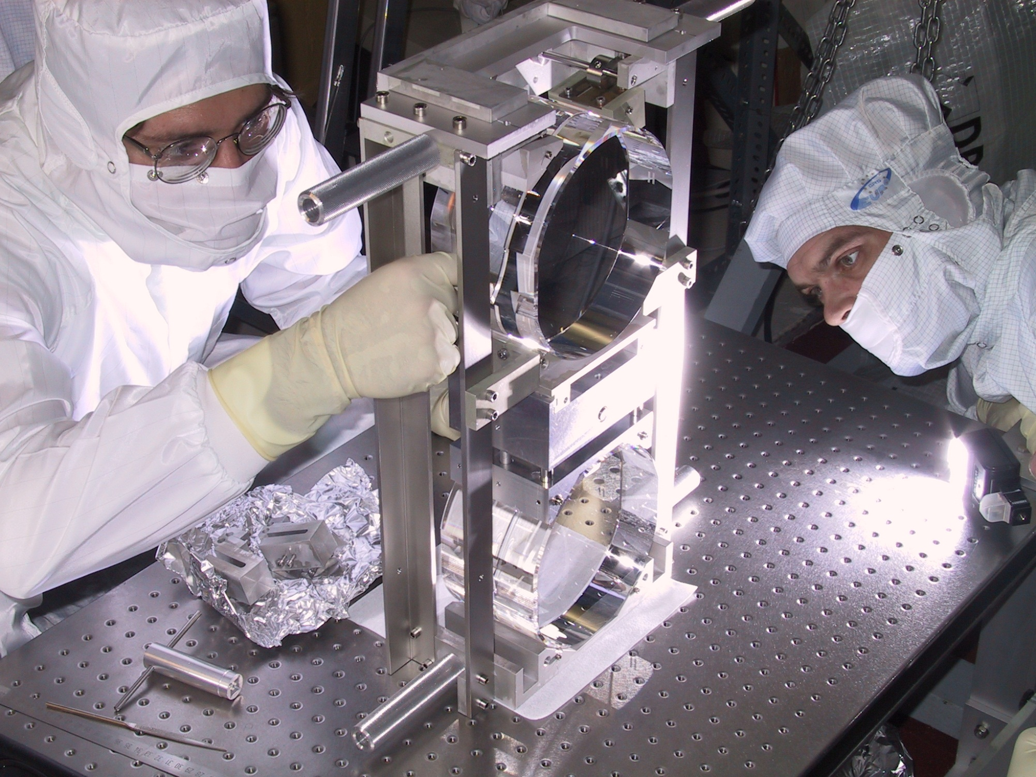

A bit of history
Braginsky first work 1993
First suspension test 1999, Glasgow
First suspension on GEO600 2000
First laser pulling machine 2005

Slide 3
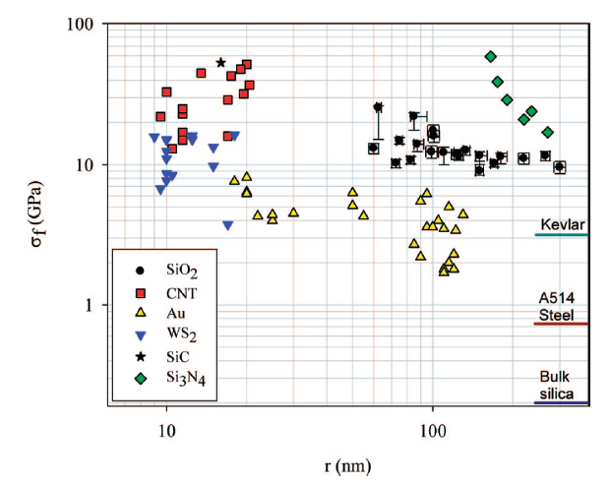
Fused silica properties
It’s resistant to longitudinal stress
It’s soft
Low thermal expansion
Positive dE/dT
Low loss
Physical properties do not change after melting
Young’s modulus is about 72 Gpa = 1/3 of steel value
Softness is important for thermal noise:
Q is proportional to ϕE
Softness is important for the vertical bouncing mode:
for LIGO f_{vert} ~ 10 Hz
G. Brambilla, Nano Letters 9 (2) 831, 2009

Slide 4
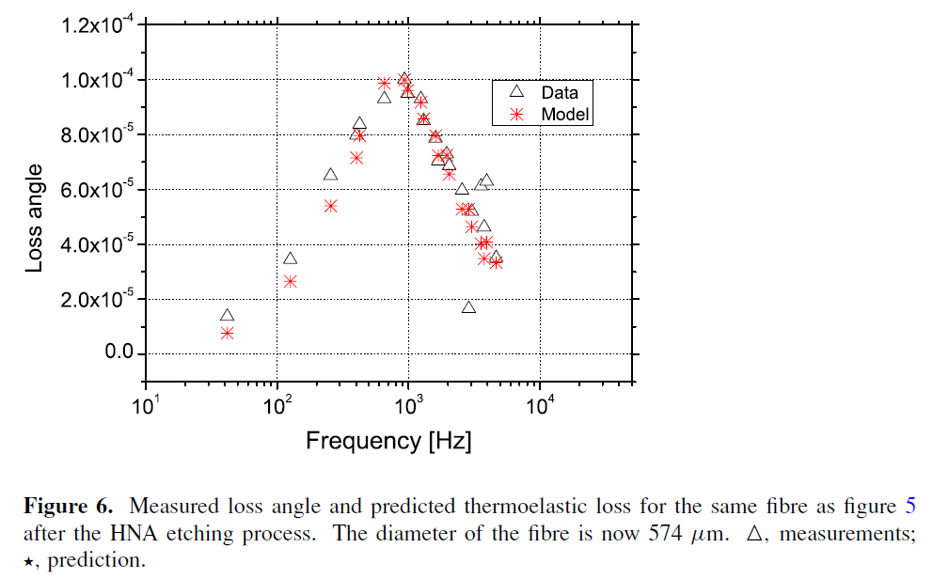
Linear thermoelastic effect
Thermoelastic damping is so precise that it can be used to measure thermal and mechanical properties of materials.
Here a crystalline Si fibre is under measurement
Asymmetric thermal fluctuations across the fibre
are responsible for the thermoelastic noise
Thermal expansion transforms thermal
fluctuations in strain fluctuations
FIBRE
PSD of pendulum noise depends also on the characteristic time τ heat takes to cross the fibre
M. Alshourbagy et al., Class. Quantum Grav.,
23 (2006) S277

Slide 5
Non linear thermoelastic effect
Strain fluctuations are coupled
to thermal fluctuation through
the term β=1/E·dE/dT, too
A permanent static strain should
be already present
Amazingly, β > 0 in fused silica:
  Thermoelastic fluctuations can
  be cancelled !!
δT
IT HAS NOT BEEN VERIFIED
BY AN EXPERIMENT YET!!
P

Slide 6
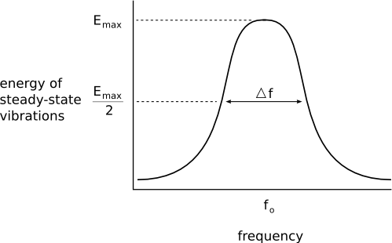
Mechanical losses
Mechanical losses are expressed in terms of loss angle ϕ
At each resonant mode ϕ is exactly Q⁻¹.
τ

Slide 7
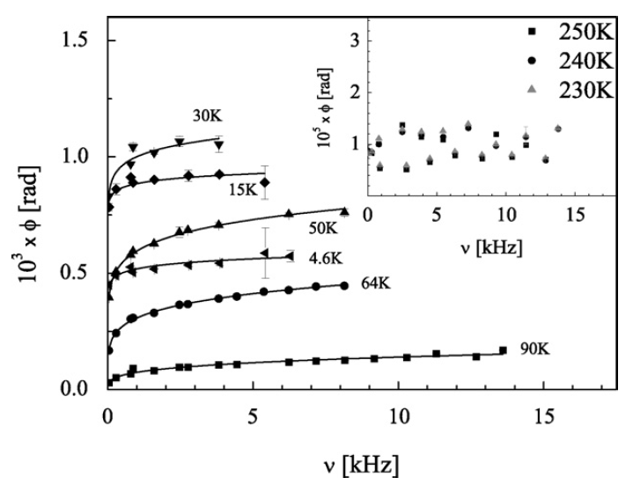
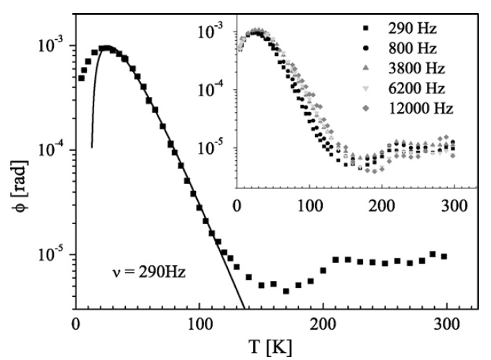
Losses in fused silica
Frequency dependence
ADWP
Relaxation
model
Surface effect +
other relaxations (?)
F. Travasso et al., Mat. Sci. Engineering A,
521-522 (2009) 268
F. Travasso et al., Mat. Sci. Engineering A,
521-522 (2009) 268

Slide 8
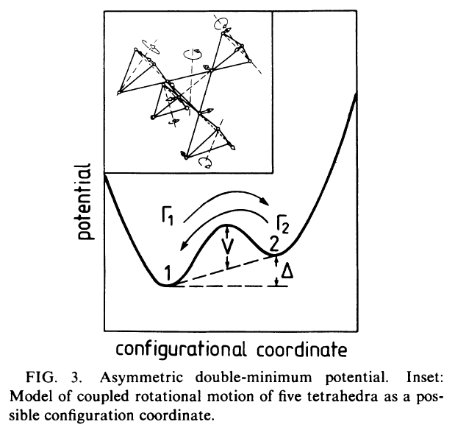
The Asymmetric Double Well Potential model
Silica smallest structure
Tetrahedras twist → modulus defect
The twist has a ADW potential
The transition
time τ depends
on V, Δ and temperature
Distribution of Vs and Δs

Slide 9
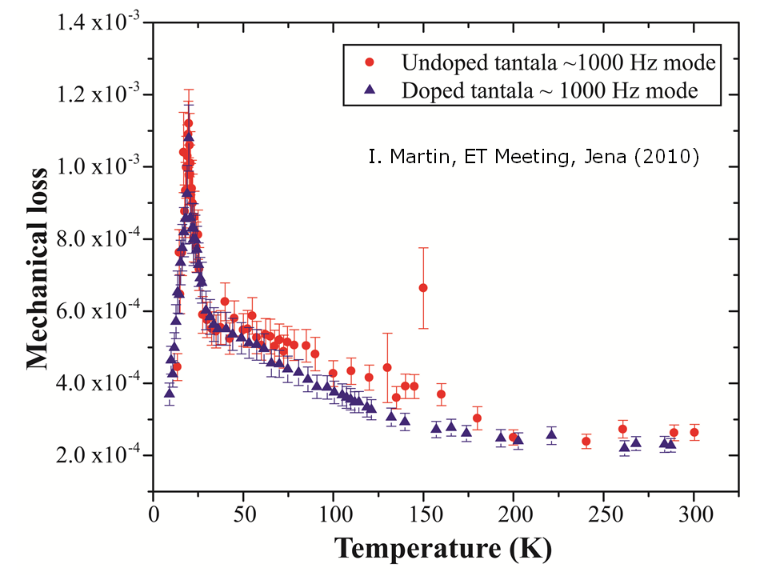
ADWP in coatings

Slide 10
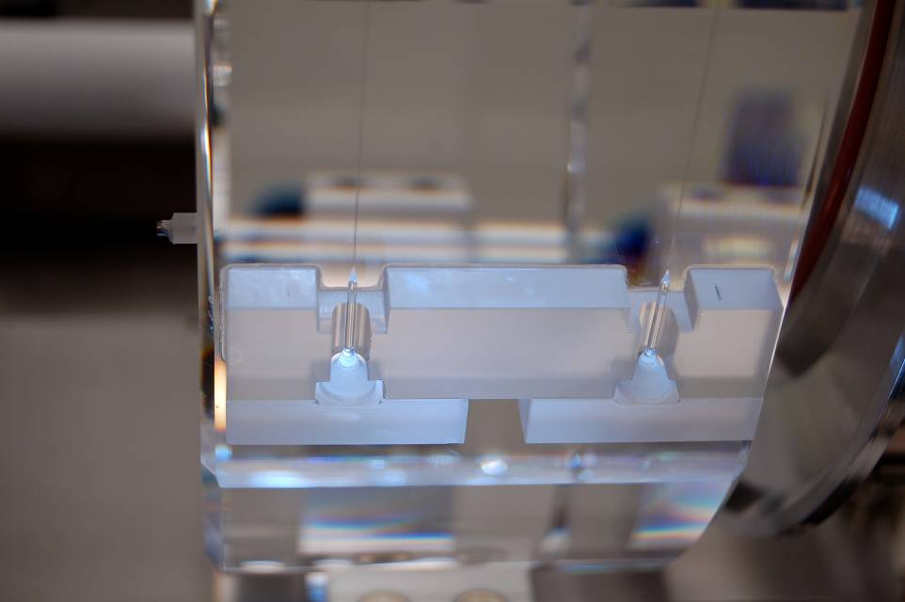
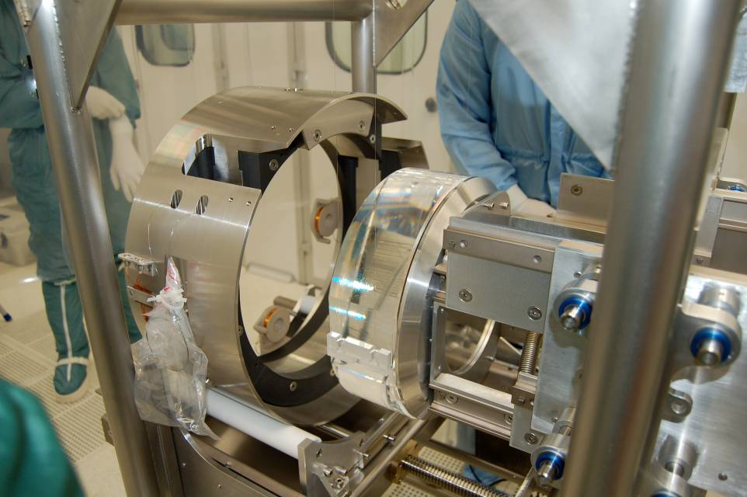
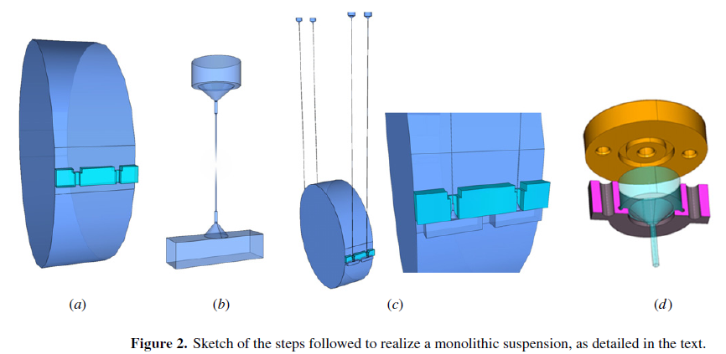
Virgo + monolithic suspensions
Silica fibres haves been pulled with the CO₂ laser machine
  Developed in Glasgow
  Modified for Virgo by the Firenze Group:
  Matteo Lorenzini, Francesco Piergiovanni
  and Filippo Martelli
M. Lorenzini, Class. Quantum Grav. 27 (2010) 084021

Slide 11
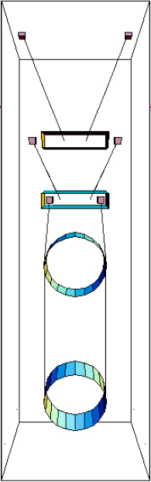
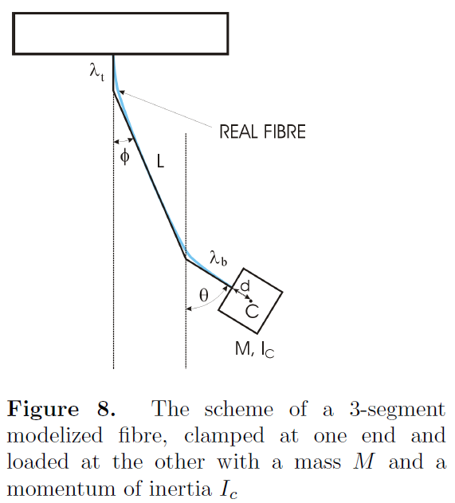

Dynamics of the suspension
3-segment model
  Created for
  suspension modeling
  It replaces the
  elastic beam
  equation method
  Thermal noise
  calculations possible
F. Piergiovanni et al., J. Phys. Conf. Series,
228 (2010) 012017
Mark Barton
G060086-00-D

Slide 12
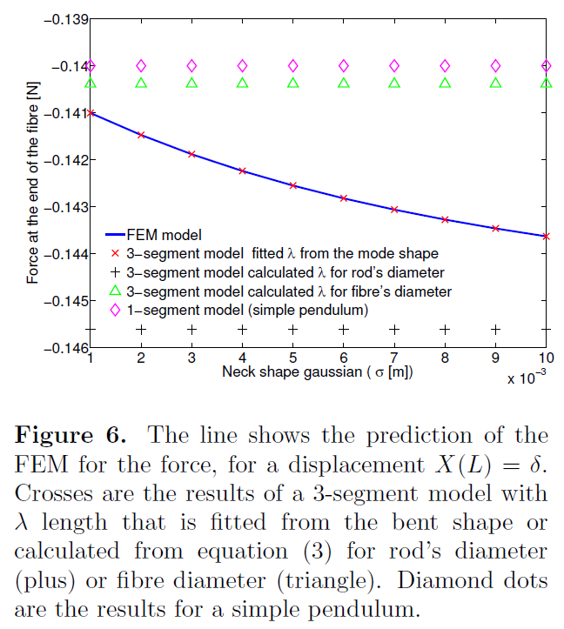
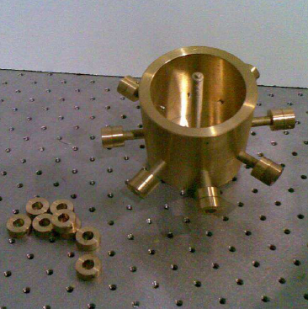
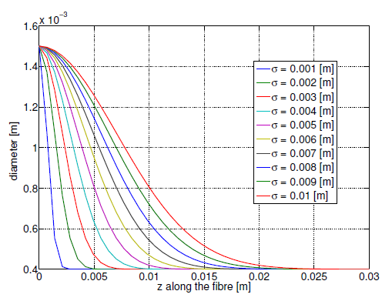
3-segment vs FEA
The comparison has been made on fibres with Gaussian shape neck
F. Piergiovanni et al., J. Phys. Conf. Series,
228 (2010) 012017
Different neck
profiles
Suspended mass. Moment of inertia I and C.o.M. position can be changed

Slide 13
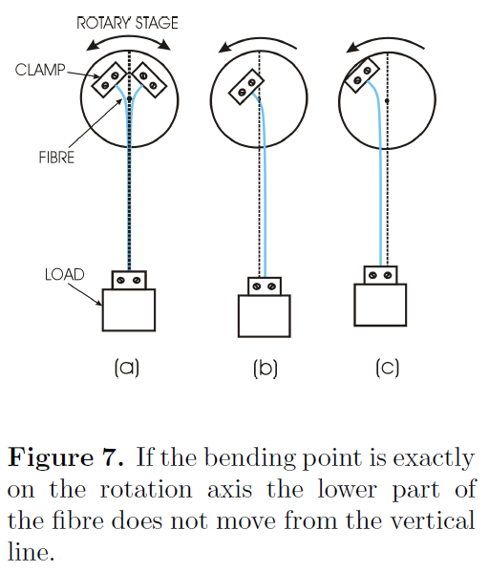
The bending point machine
We have developed a machine able to detect the bending point in FS fibres with a precision of 0.1 mm
The machine measures the vertical bouncing and the violin mode frequencies (as done in GEO600) for a full characterization of each fibre
F. Piergiovanni et al., J. Phys. Conf. Series,
228 (2010) 012017
MOVIE

Slide 14
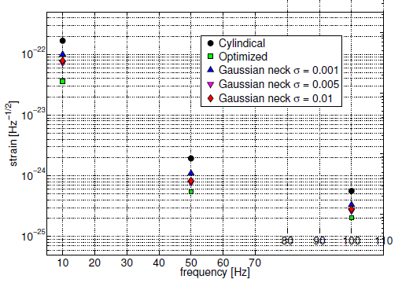
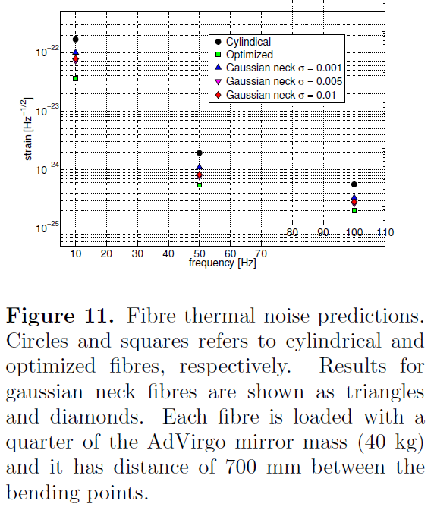
The optimal fibre shape
The optimal shape is the dumbbell
Thermoelastic noise is cancelled at the thick ends whereas the thinner part makes the bouncing mode low and violin mode high

Slide 15
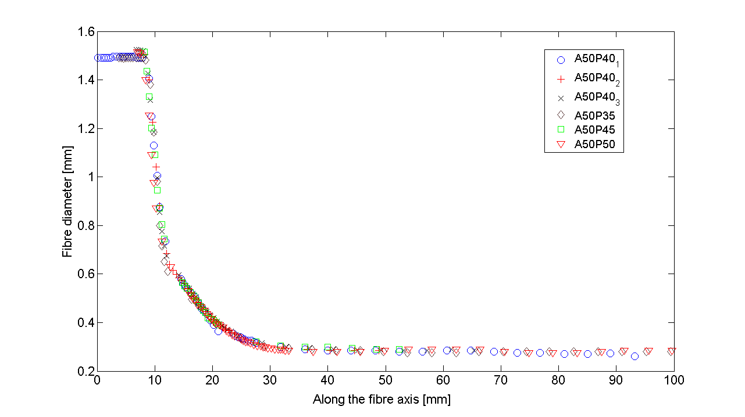
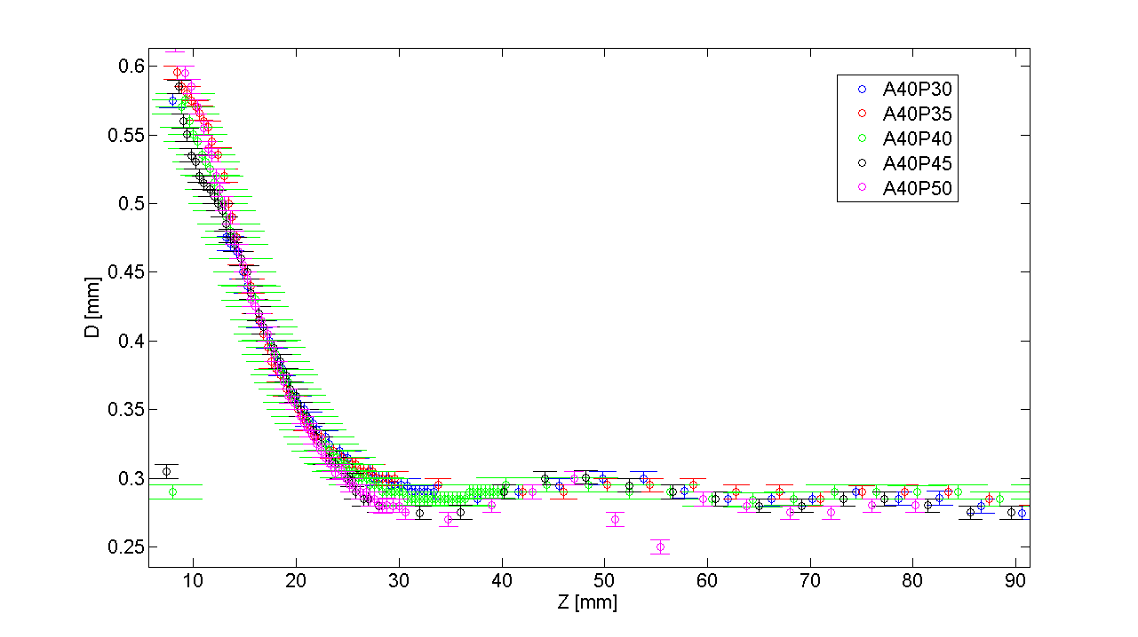
The problem of the fibre shape
Speed ratio fixes the diameter of pulled fibre but:
  At the beginning of pulling other effects are relevant
  If the fibre is pulled at constant speed the profile comes out with a neck thinner than the middle fibre diameter
  Two approaches: 1) more physics;
  2) try out speed functions
M. Lorenzini, Amaldi 2009
F. Piergiovanni, private communication

Slide 16
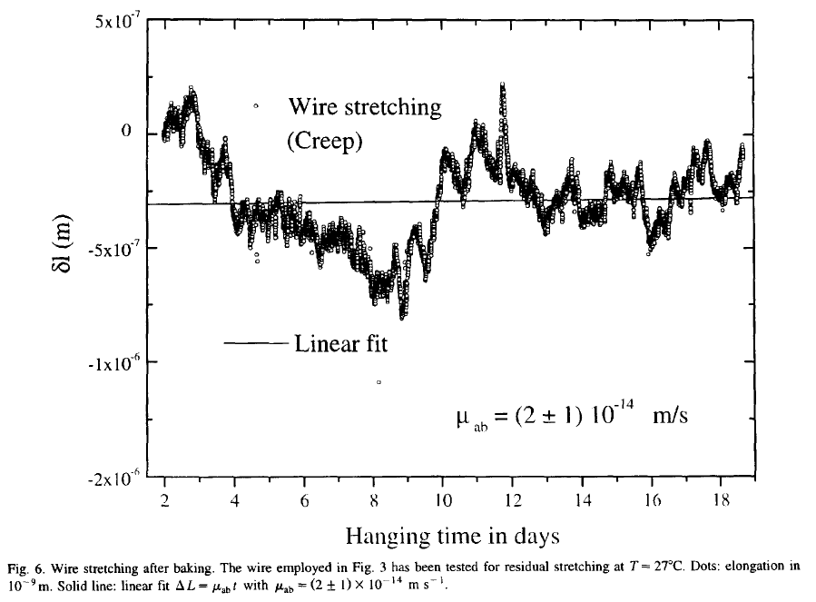
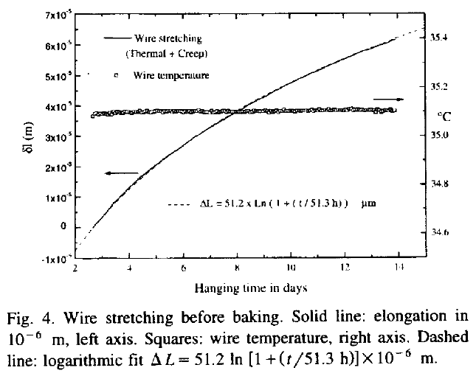
Suspension Creep
First transfer
function: wave
propagation
This phenomenon was address in Virgo for the steel suspensions
Creep occurs in wires and in blades
Creep microscopic events:
  The length of wires suddenly increases by 10⁻¹⁰ m or less
  The actual displacement of the mass depends on its transfer function
Length
increase
q_{L}
Second transfer function:
mass dynamics

Slide 17
Creep in hydroxide-catalysis bonding?
FS fibres are known to have the creep regime overlapped with the rupture of material
Hydroxide-catalysis bonding may have creep due to a non-homogeneous curing of bonding
A direct measurement has been proposed:
  Not on suspended masses because of their low-pass filtering transfer function

Slide 18
Proposed activity for aLIGO
Investigation on creep noise
  Shear stress due to mirror weight and thermal gradient due to thermal compensation may cause creep in the silicate bonding layer
  Previous works have searched for indirect evidence of such noise (violin modes amplitude monitoring) B Sorazu et al 2010 Class. Quantum Grav. 27 155017
  Direct detection is proposed here
Relevance for aLIGO
  Minimizing the risk of having creep noise from bonding
  A test for thermal compensation

Slide 19
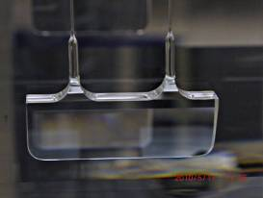
Direct measurement of creep noise
Measurement done on samples
  Test mass is pulled by its own
  weight → “slow” motion
  Low mass ear moves very fast
  when tension is released
  Vacuum conditions to avoid possible effect of air
  F-P cavity to detect events of magnitude 10⁻¹² m
COURTESY OF GLASGOW
FREQUENCY
STABILIZED
LASER
F-P CAVITY
100×2 N
Heat

